Slide 1
CS 170 Knowledge pt 3
Notes based from Dr. Eamonn Keogh

Slide 2
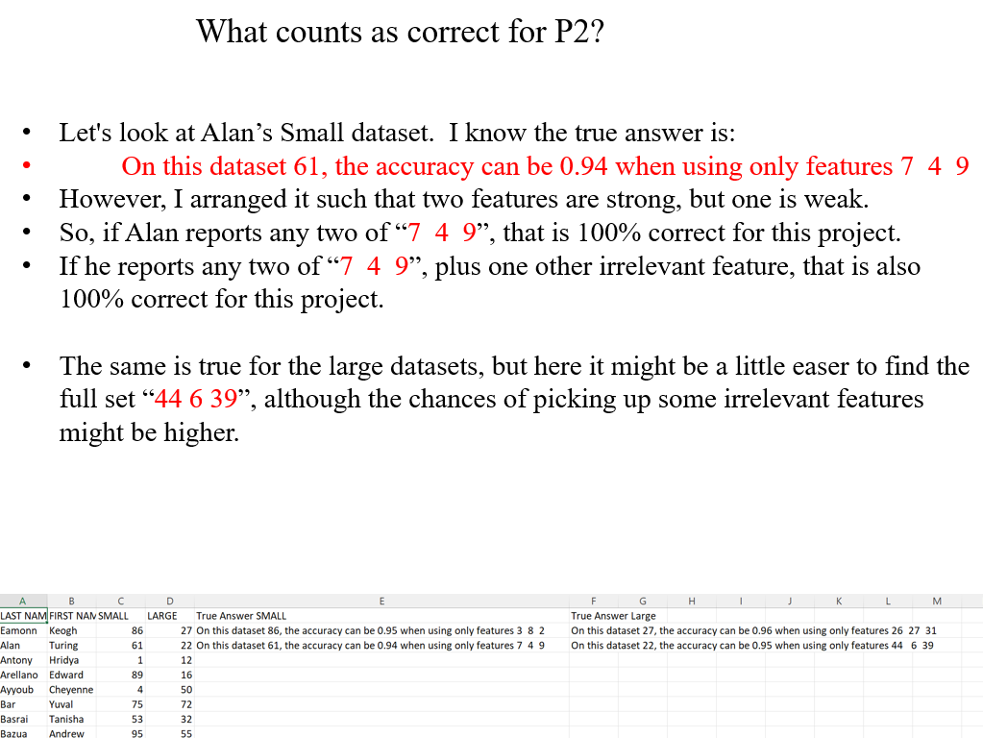

Slide 3
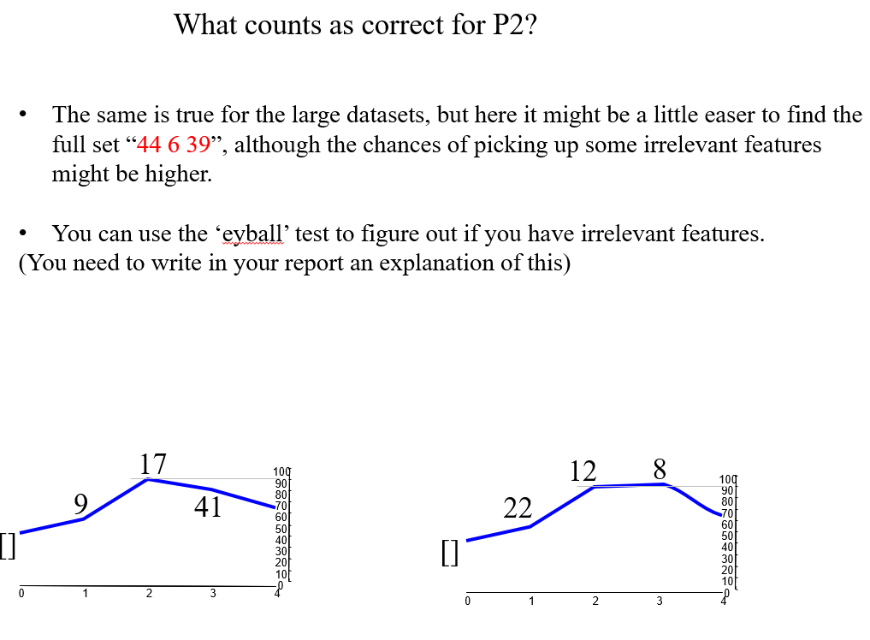

Slide 4


Slide 5
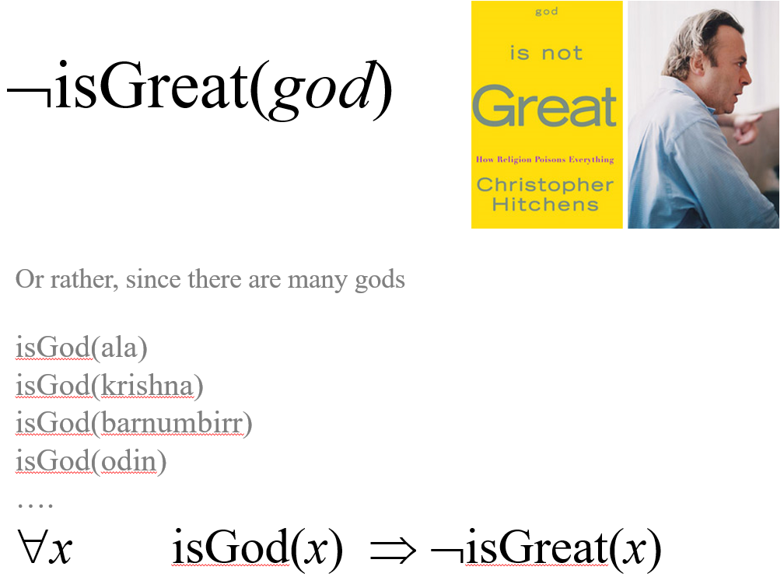

Slide 6
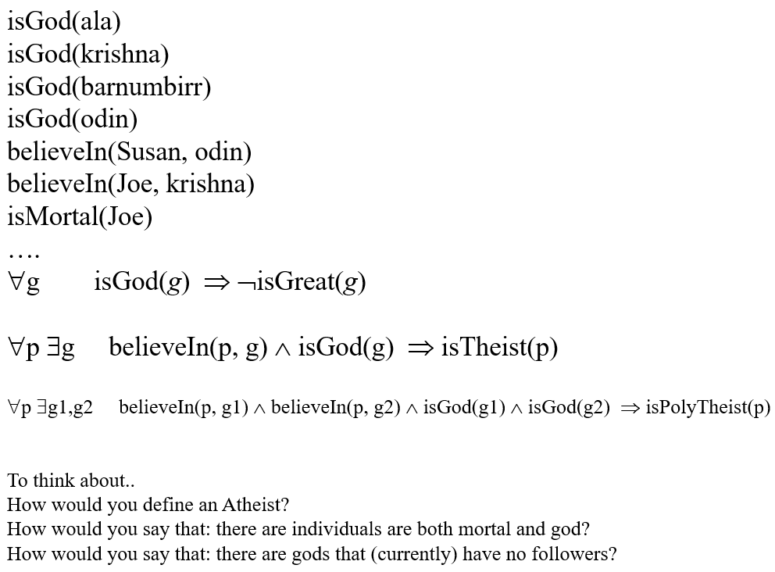

Slide 7
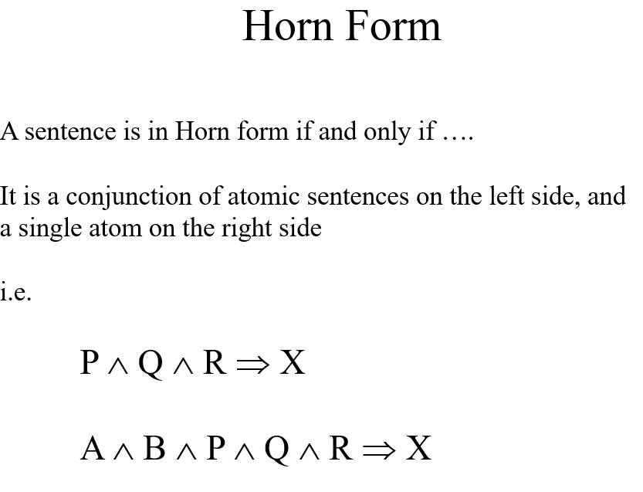

Slide 8
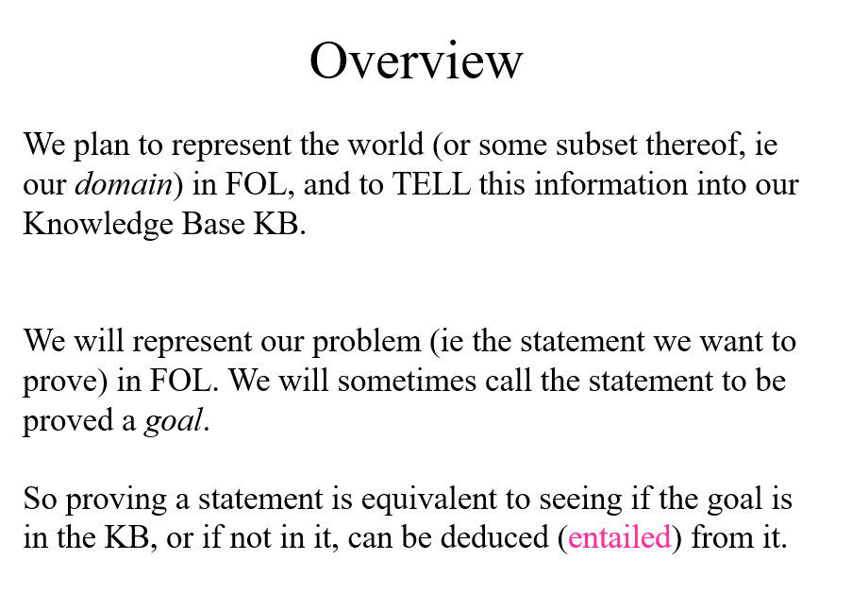

Slide 9
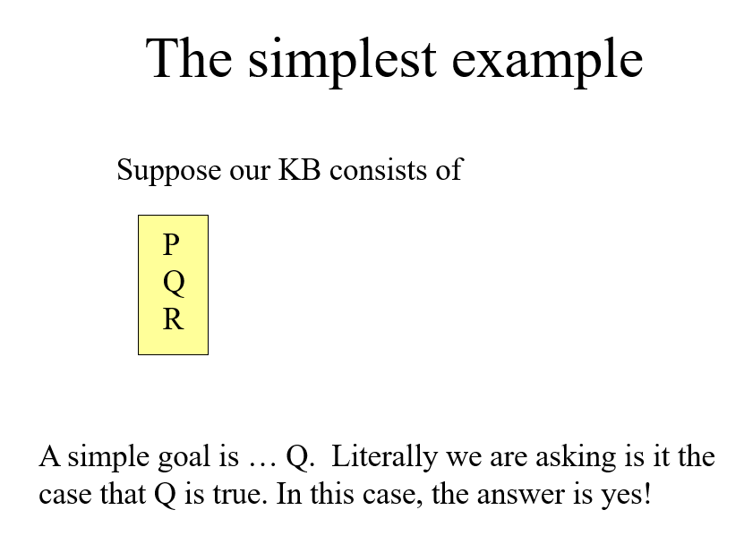

Slide 10
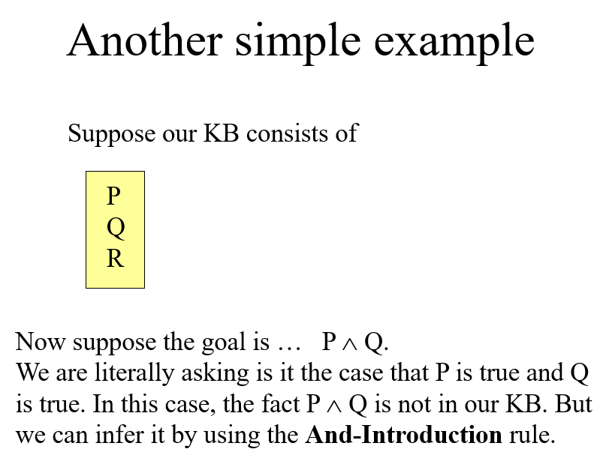

Slide 11
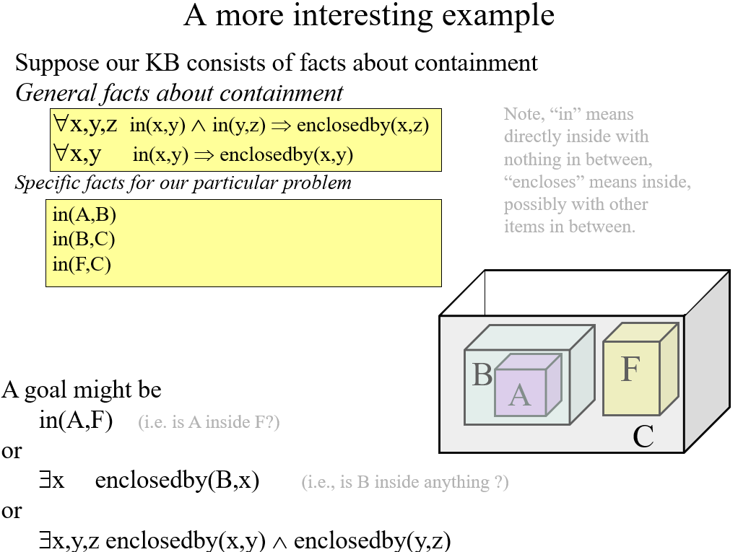

Slide 12
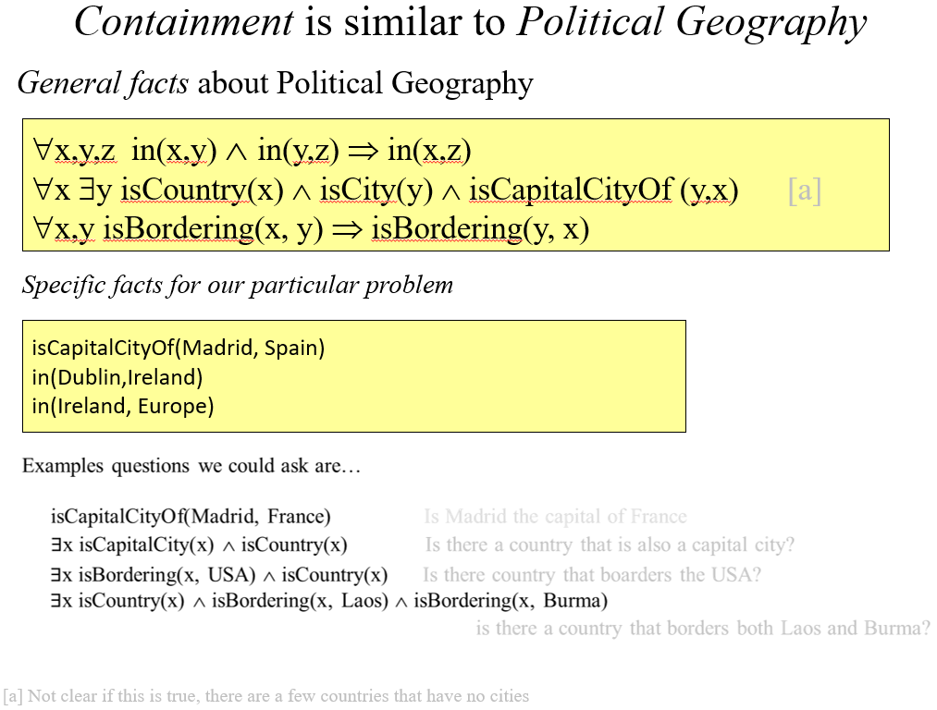

Slide 13
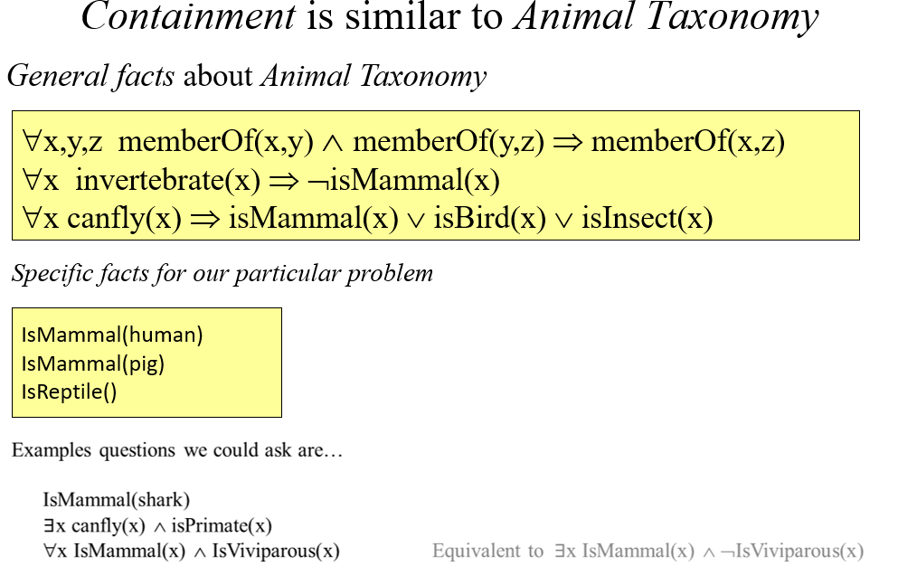

Slide 14
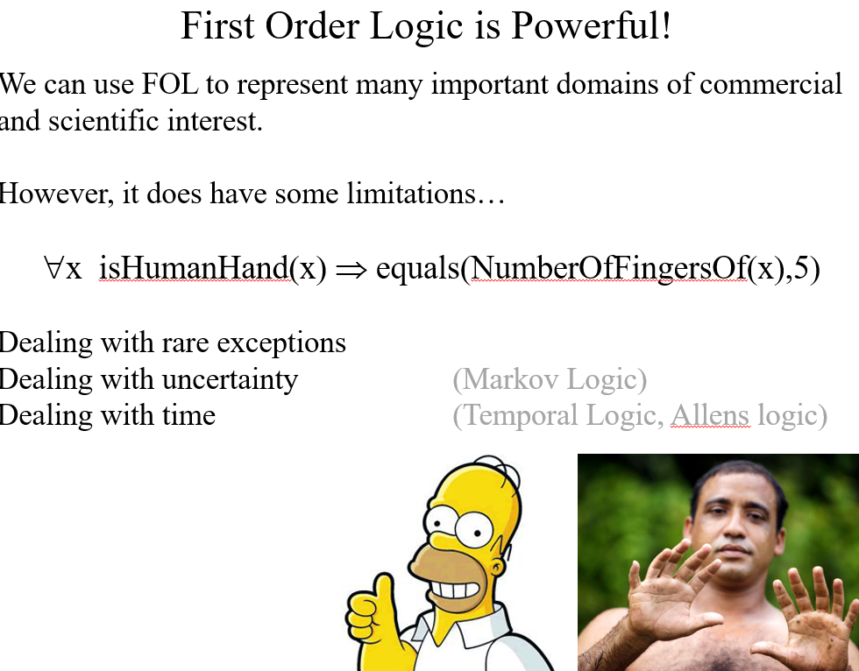

Slide 15
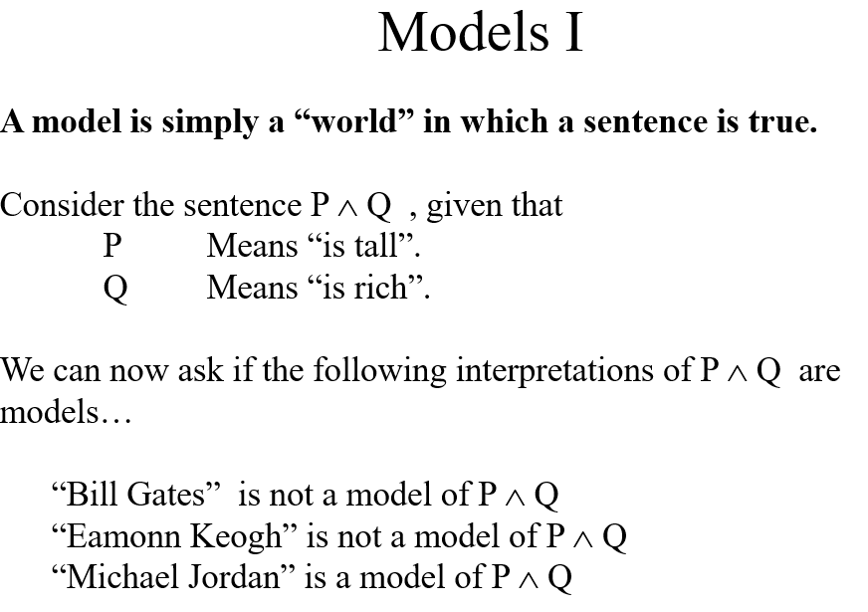

Slide 16
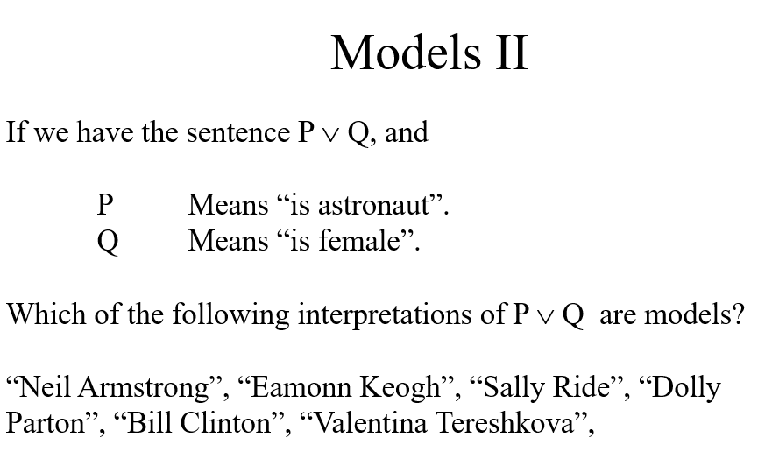

Slide 17
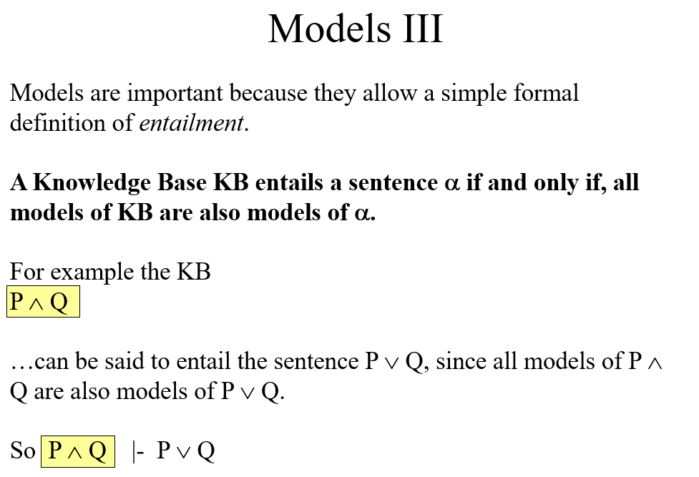

Slide 18
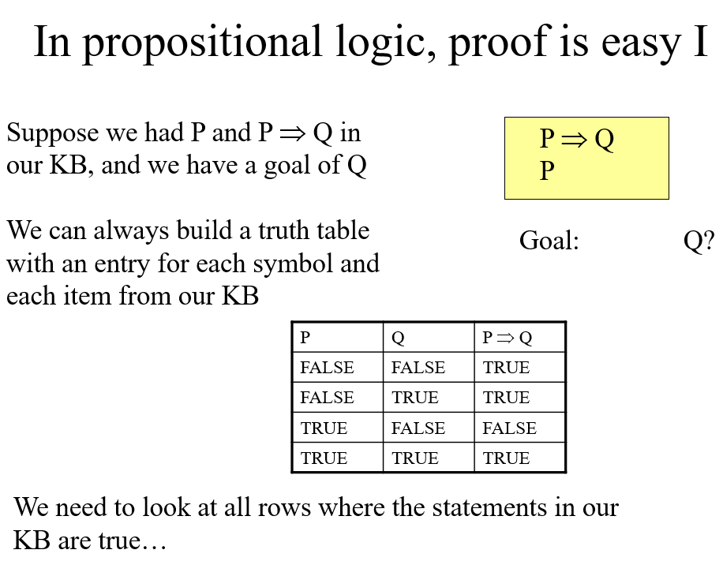

Slide 19
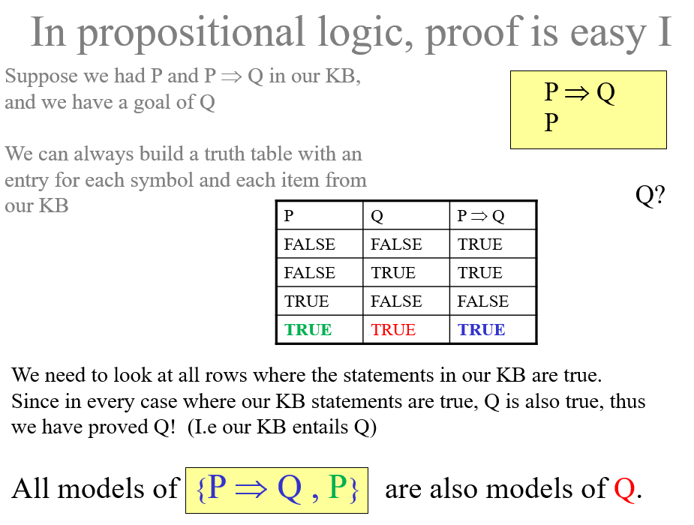

Slide 20
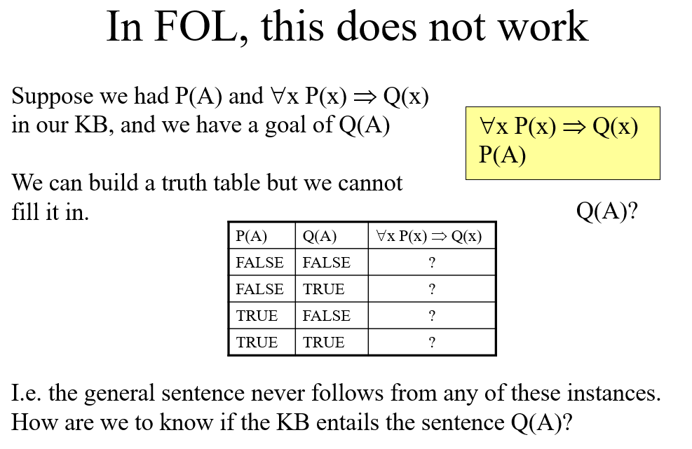

Slide 21
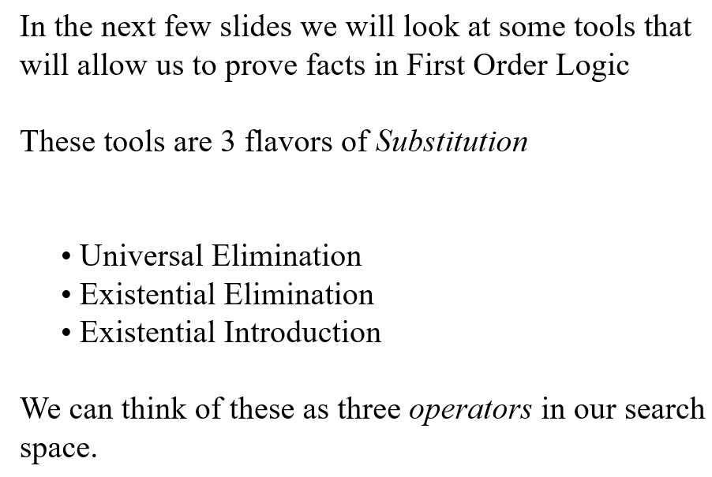

Slide 22
Substitution (Binding, Instantiation)
Substitution is a variable (or set of variables) paired with a term.
Example: SUBST{x/Harpo} is a substitution indicating that Harpo should be substituted for x.
Brother(x,Groucho) becomes Brother(Harpo,Groucho)
Example: SUBST{x/YoungestSonOF(Minnie)}is a substitution indicating that YoungestSonOF(Minnie)} should be substituted for x.
Brother(x,Groucho) becomes Brother(YoungestSonOF(Minnie),Groucho)s

Slide 23
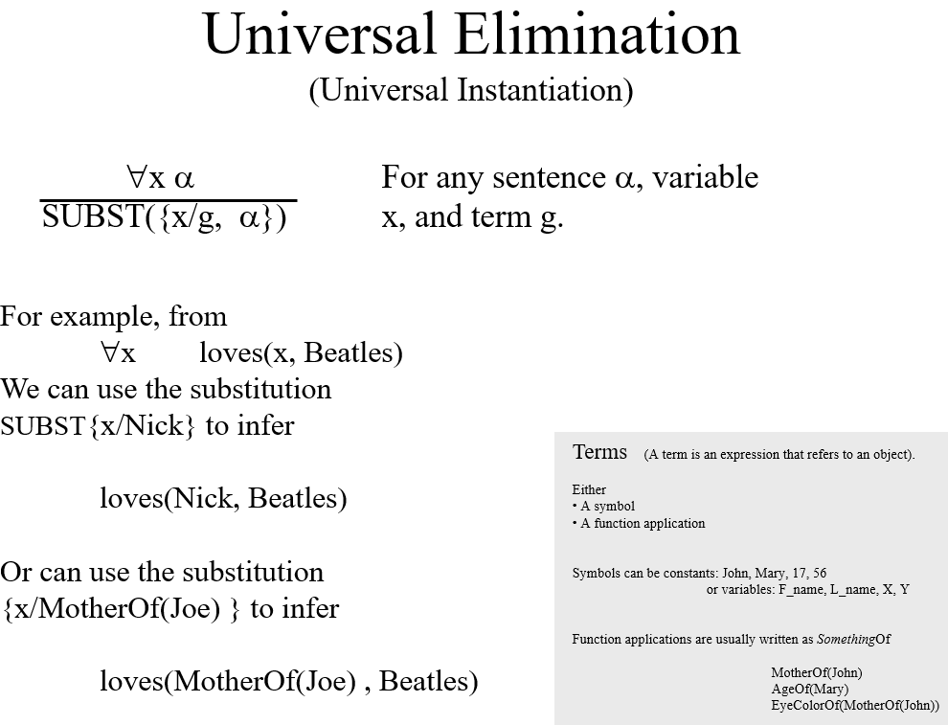

Slide 24
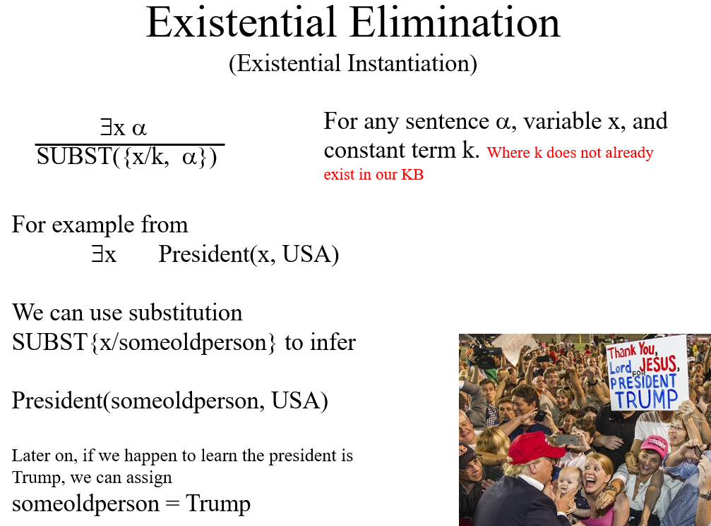

Slide 25
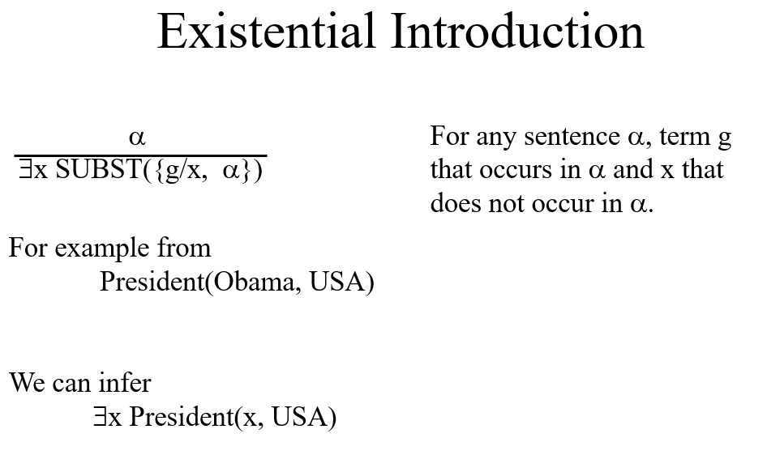

Slide 26
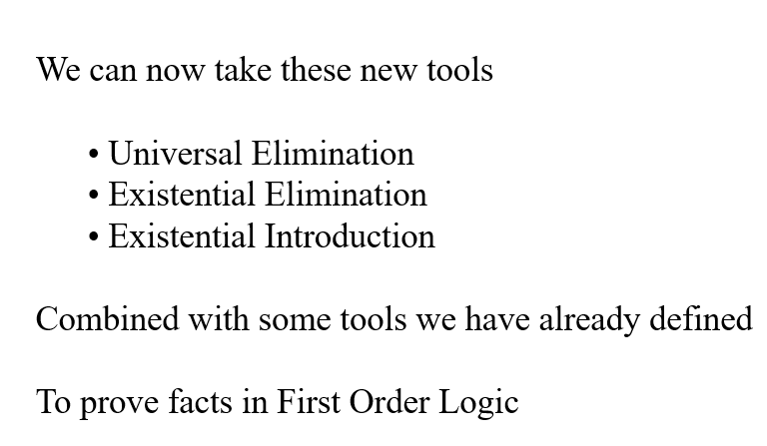

Slide 27
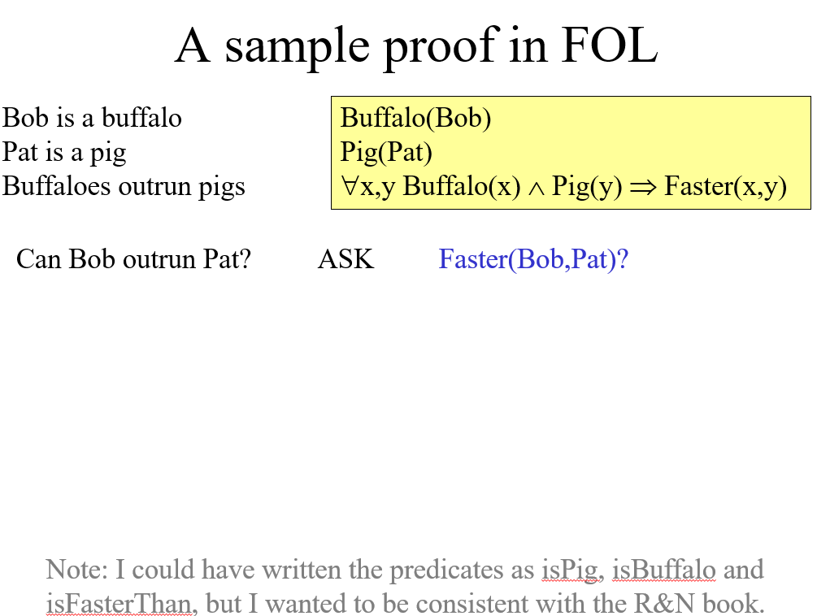

Slide 28
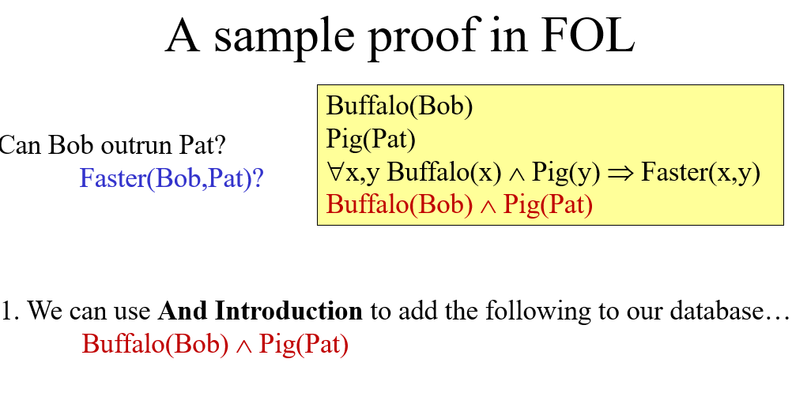

Slide 29
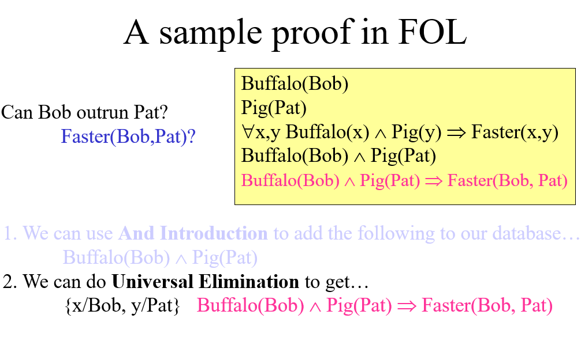

Slide 30
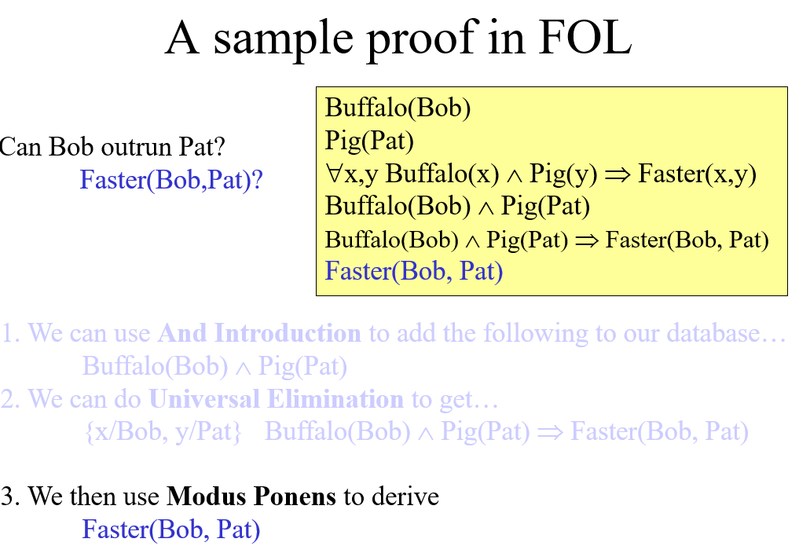

Slide 31
The need for a better proof mechanism
The proof mechanism we have just seen can be imagined as search.
The operators are inference rules (Existential Introduction, Universal Elimination, etc)
The states are set of sentences (The KB itself)
The goal test is to see if a state contains the query sentence.
This idea works, but…
It seriously slows down when the KB gets larger, because the number of possible substitutions grows exponentially.
One possible solution is to reduce the number of operators…
This leads us to Generalized Modus Ponens (GMP).

Slide 32
Generalized Modus Ponens GMP
GMP (shown in the next slide) looks very complicated.
Here is the way to think about it. For Farmer-Wolf-Duck-Corn we could have had operators such as:
Untie the boat
Place the goat into the boat
Step into the boat
Grab hold of the oars
Row the boast
Tie up the boat
Remove the goat from the boat
Place the corn into the boat
Etc
But this would have made our search tree both deeper and bushier. Instead, we had just four operators:
Move goat to other side
Move corn to other side
Move wolf to other side
Move self (only) to other side
This make the search much more efficient.

Slide 33
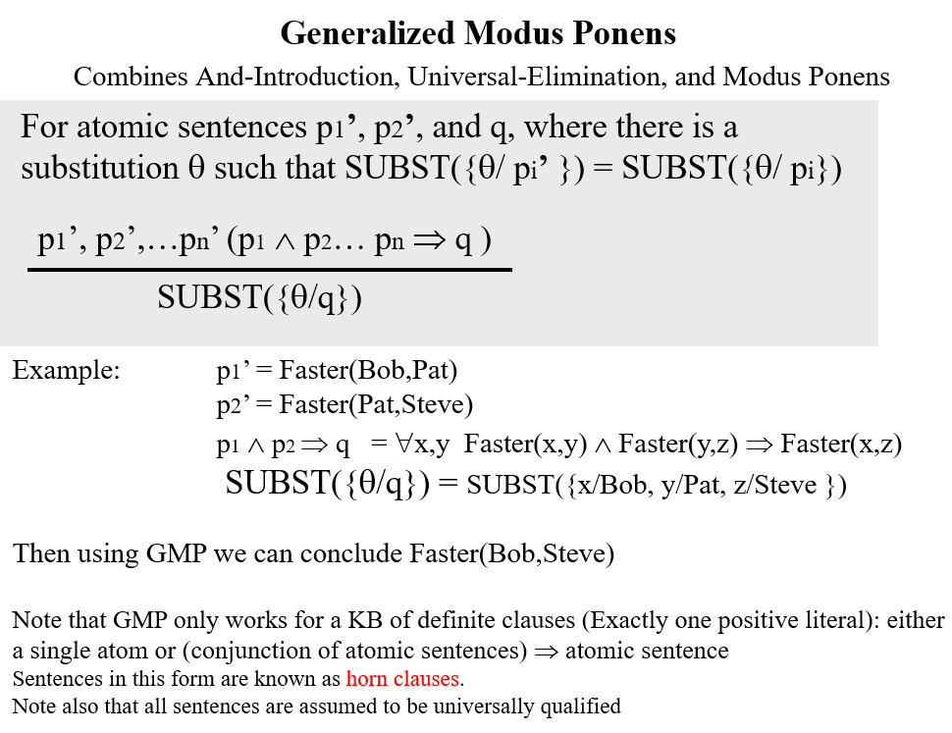

Slide 34
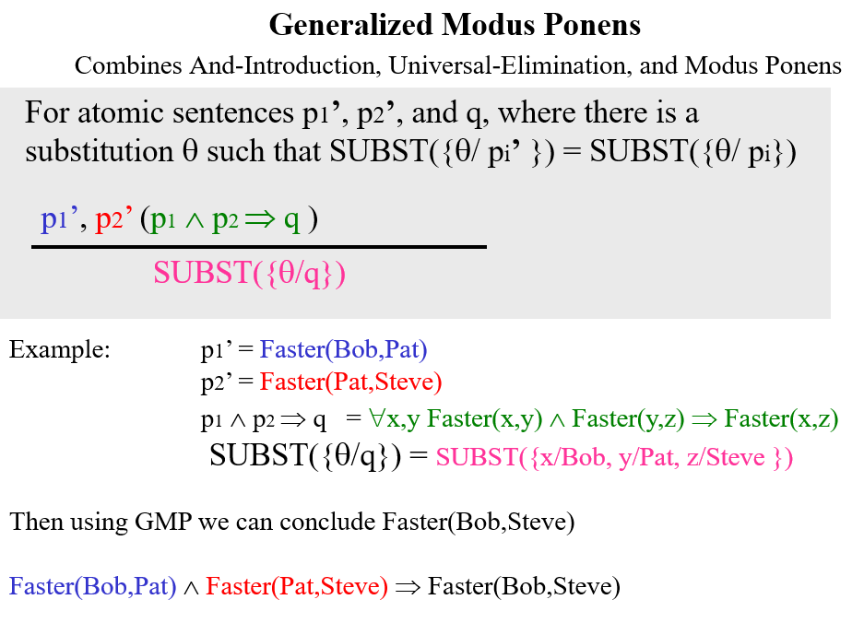

Slide 35
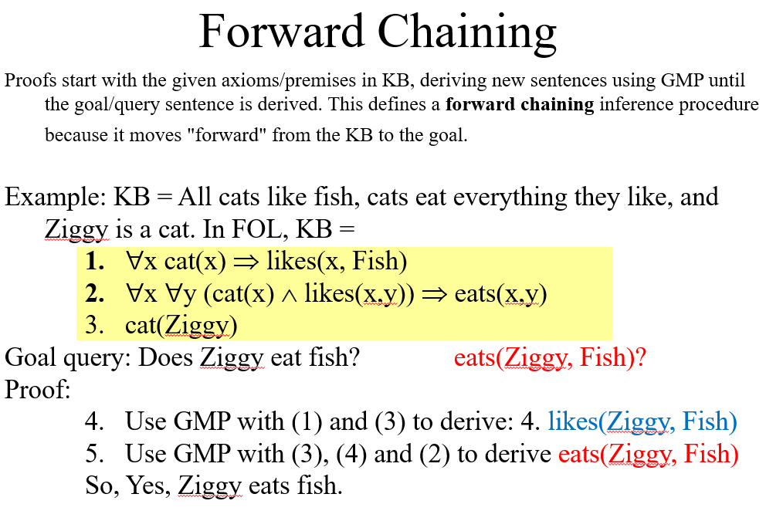

Slide 36
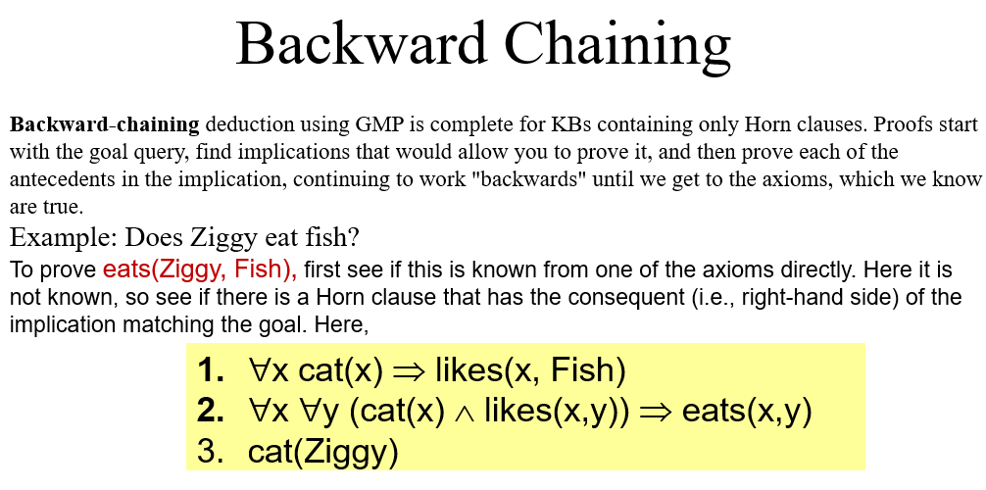

Slide 37
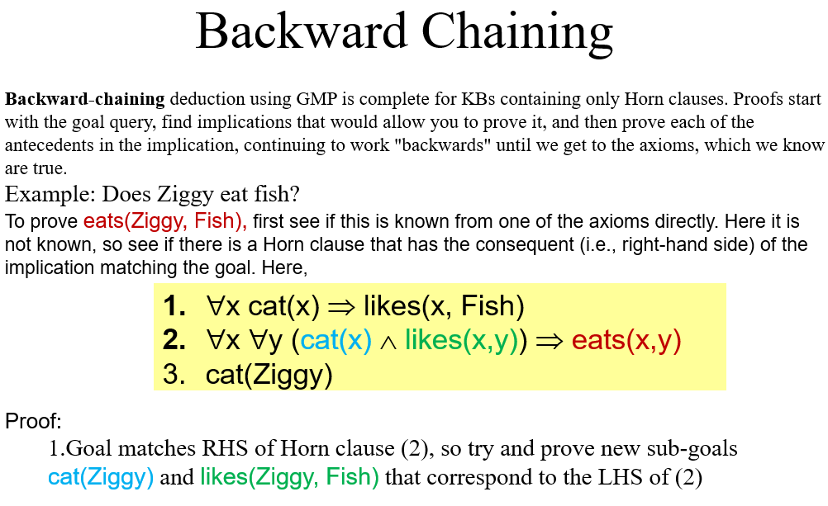

Slide 38
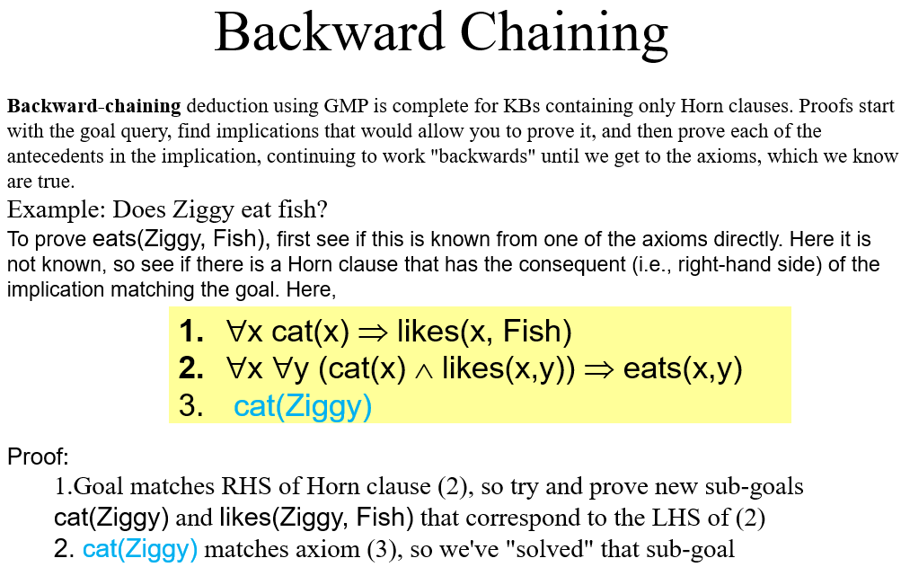

Slide 39
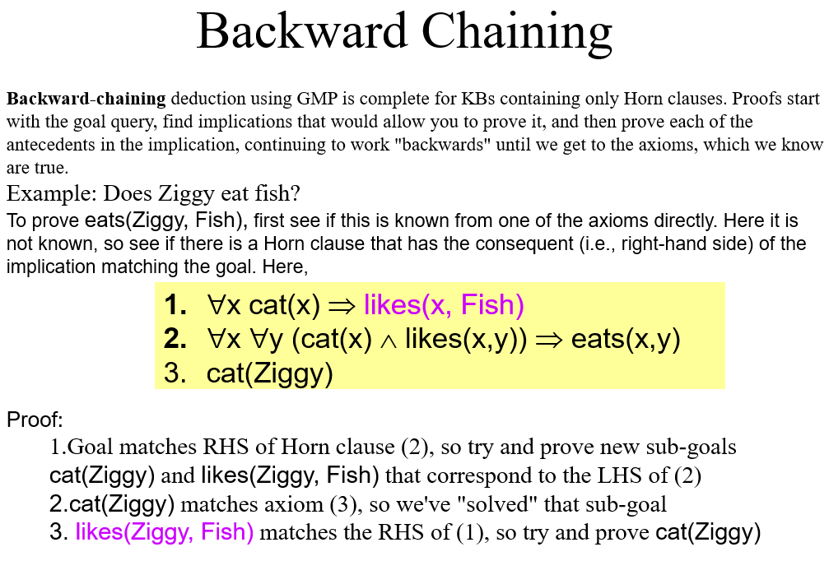

Slide 40
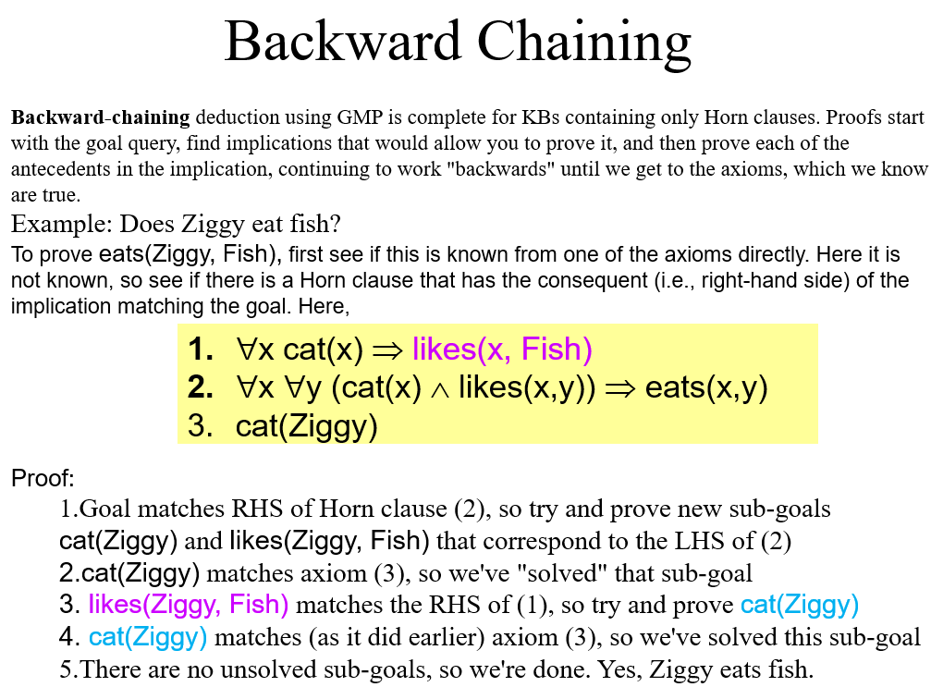

Slide 41
We have seen that we can use Generalized Modus Ponens (GMP) combined with search to see if a fact is entailed from a Knowledge Base.
Unfortunately, there are some facts that we cannot prove using GMP
Suppose we have in our KB
GoToSchool(Joe) ⇒ GoToSchool(Sue)
¬GoToSchool(Joe) ⇒ GoToSchool(Sue)
And we want to know if GoToSchool(Sue)
Although humans can look at such a KB and immediately see that GoToSchool(Sue) is true, GMP cannot entail that fact!!
So GMP is not complete.

Slide 42
Is there any complete inference procedure for FOL?
Yes! It is called resolution refutation (or just resolution).
It is complete.
It is sound.
It is optimally efficient.
It works for KB in any format unlike GMP which only works for KBs in Horn clause format (although we generally have to reorganize the format).

Slide 43
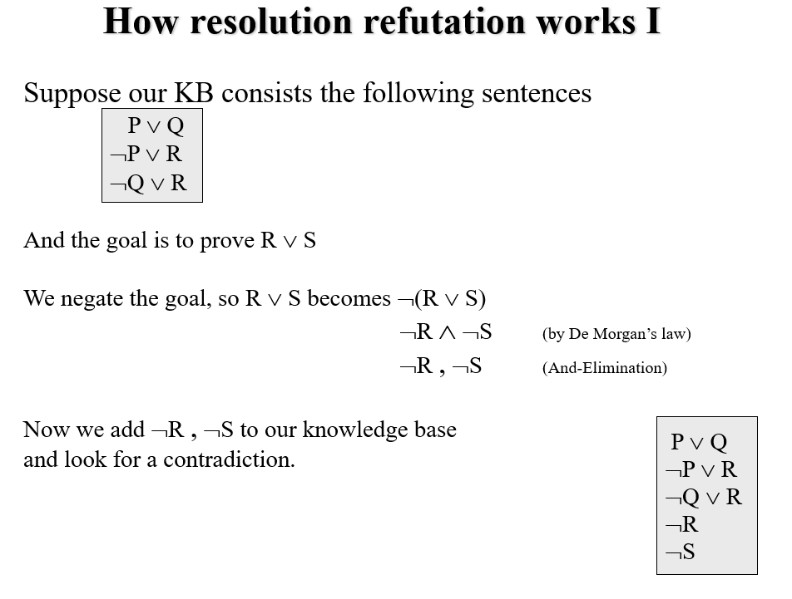

Slide 44
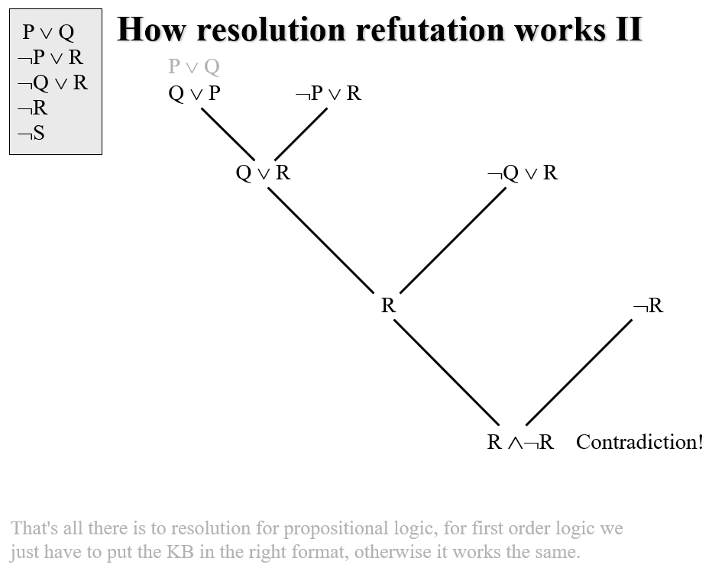

Slide 45
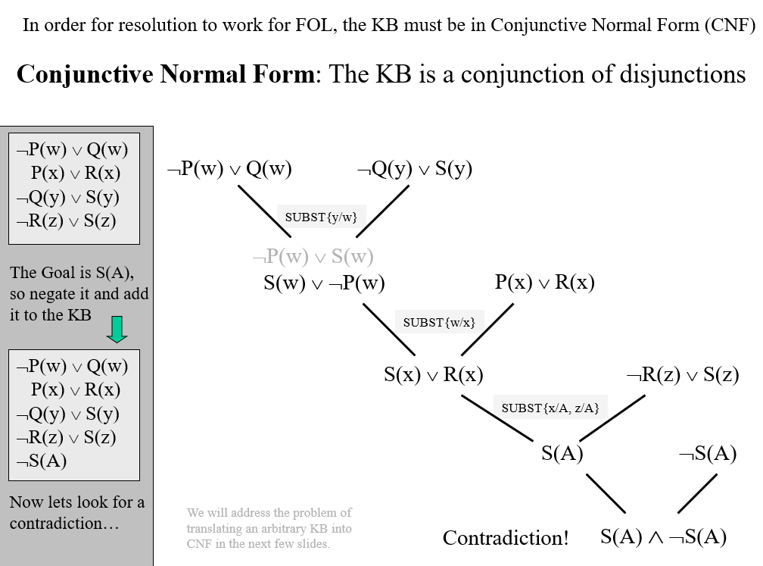

Slide 46
We have seen that we can do resolution when the KB is in CNF.
But most KB are not is that format.
Theorem: We can convert any KB to CNF
Eliminate Implications
Move ¬ inwards
Standardize Variables
Move Quantifiers left
Skolemize {Eliminate Existential Quantifiers, Drop Universal Quantifiers }
Distribute ∧ over ∨
Flatten nested conjunctions and disjunctions.
Note that we must do the steps in order!

Slide 47
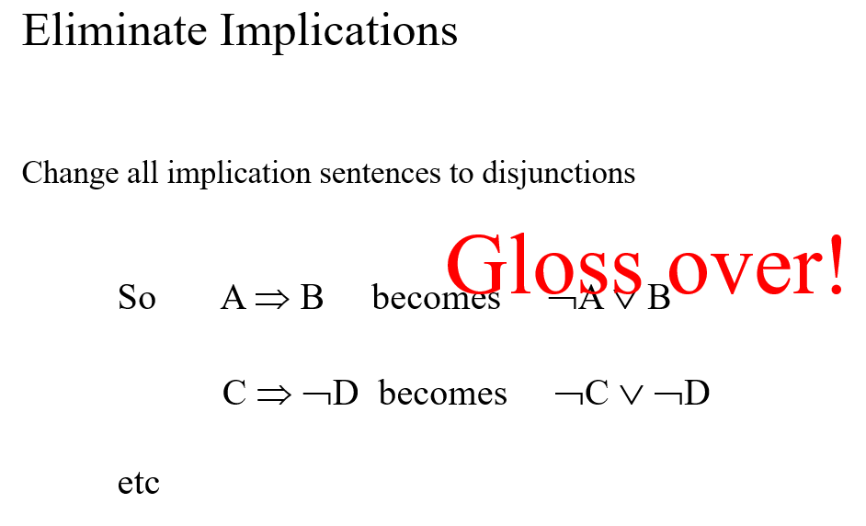

Slide 48
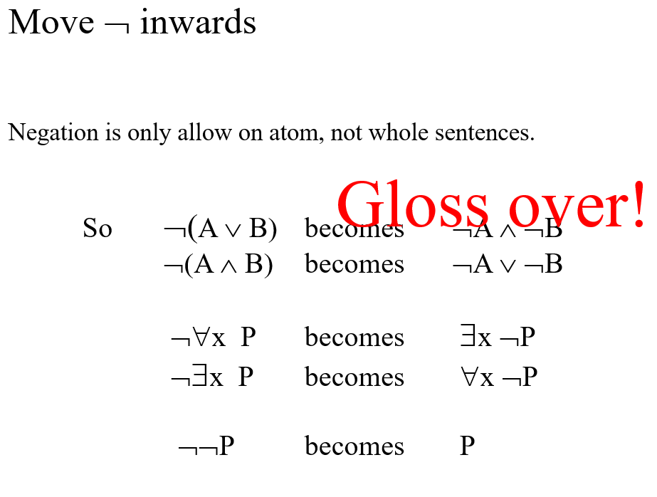

Slide 49
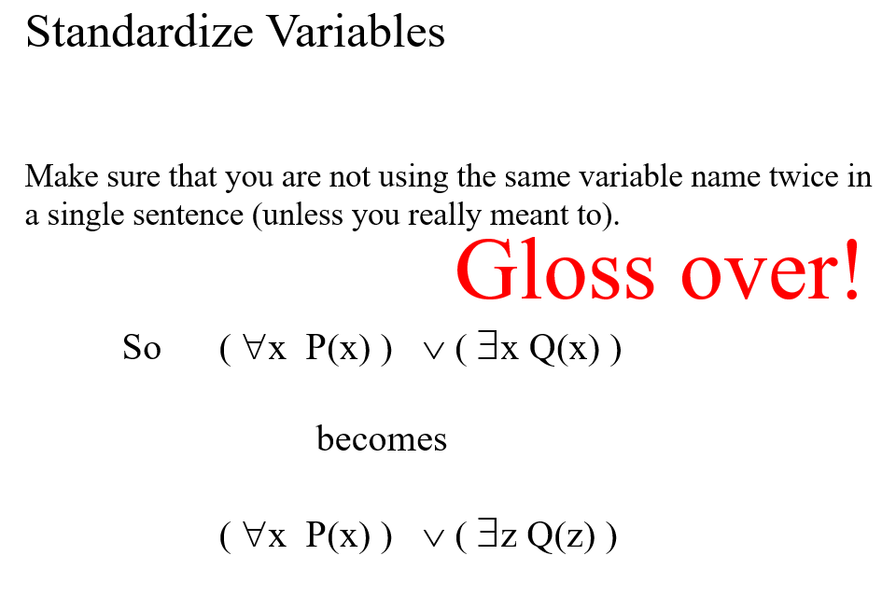

Slide 50
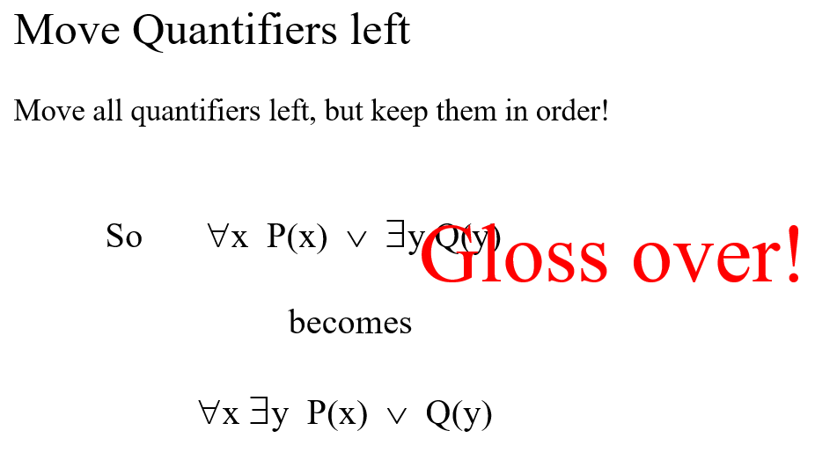

Slide 51
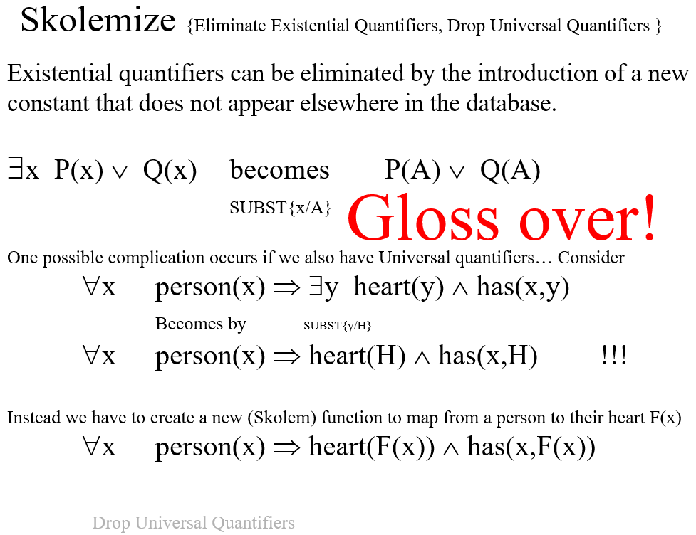

Slide 52
Distribute ∧ over ∨
(A ∧ B) ∨ C becomes (A ∨ C) ∧ (A ∨ B)
Just like distribution in arithmetic
(5 + 4) * 6 becomes (5 * 6 ) + (4 * 6 )
Gloss over!

Slide 53
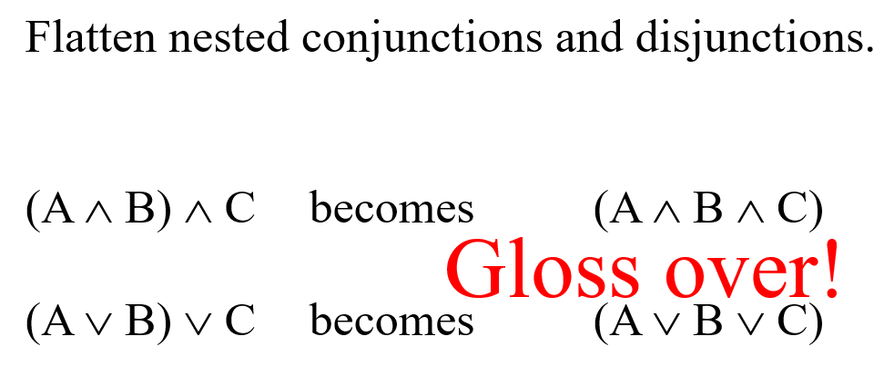

Slide 54
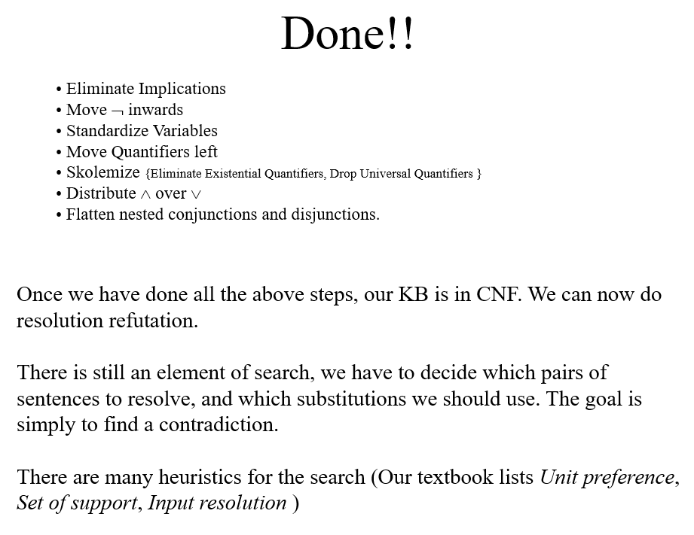

Slide 55
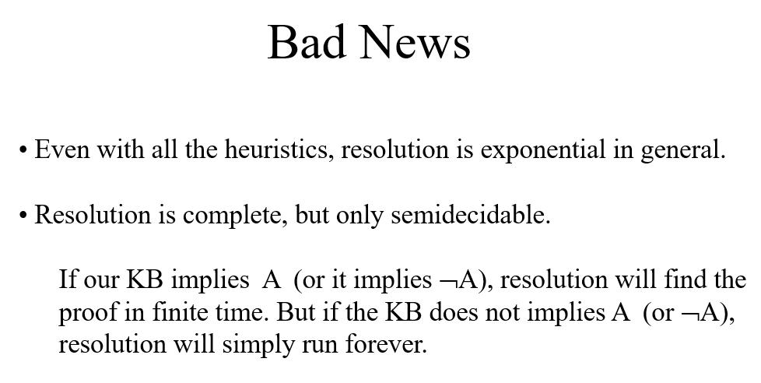

Slide 56
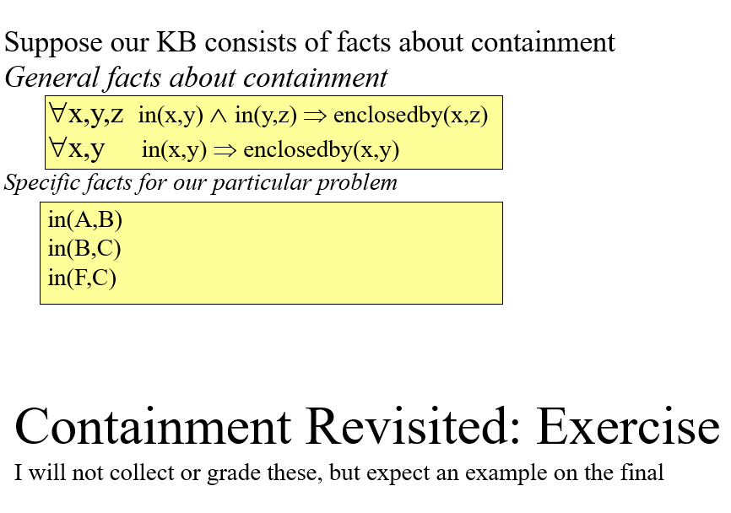

Slide 57
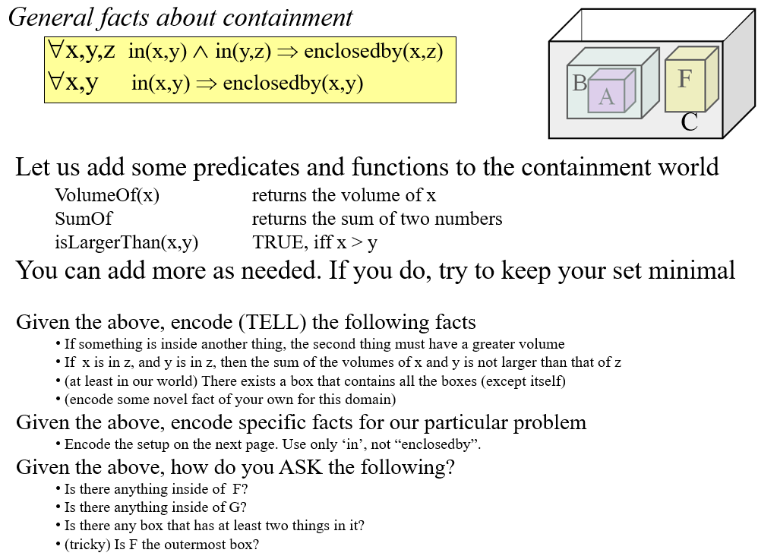

Slide 58
